Slide 1
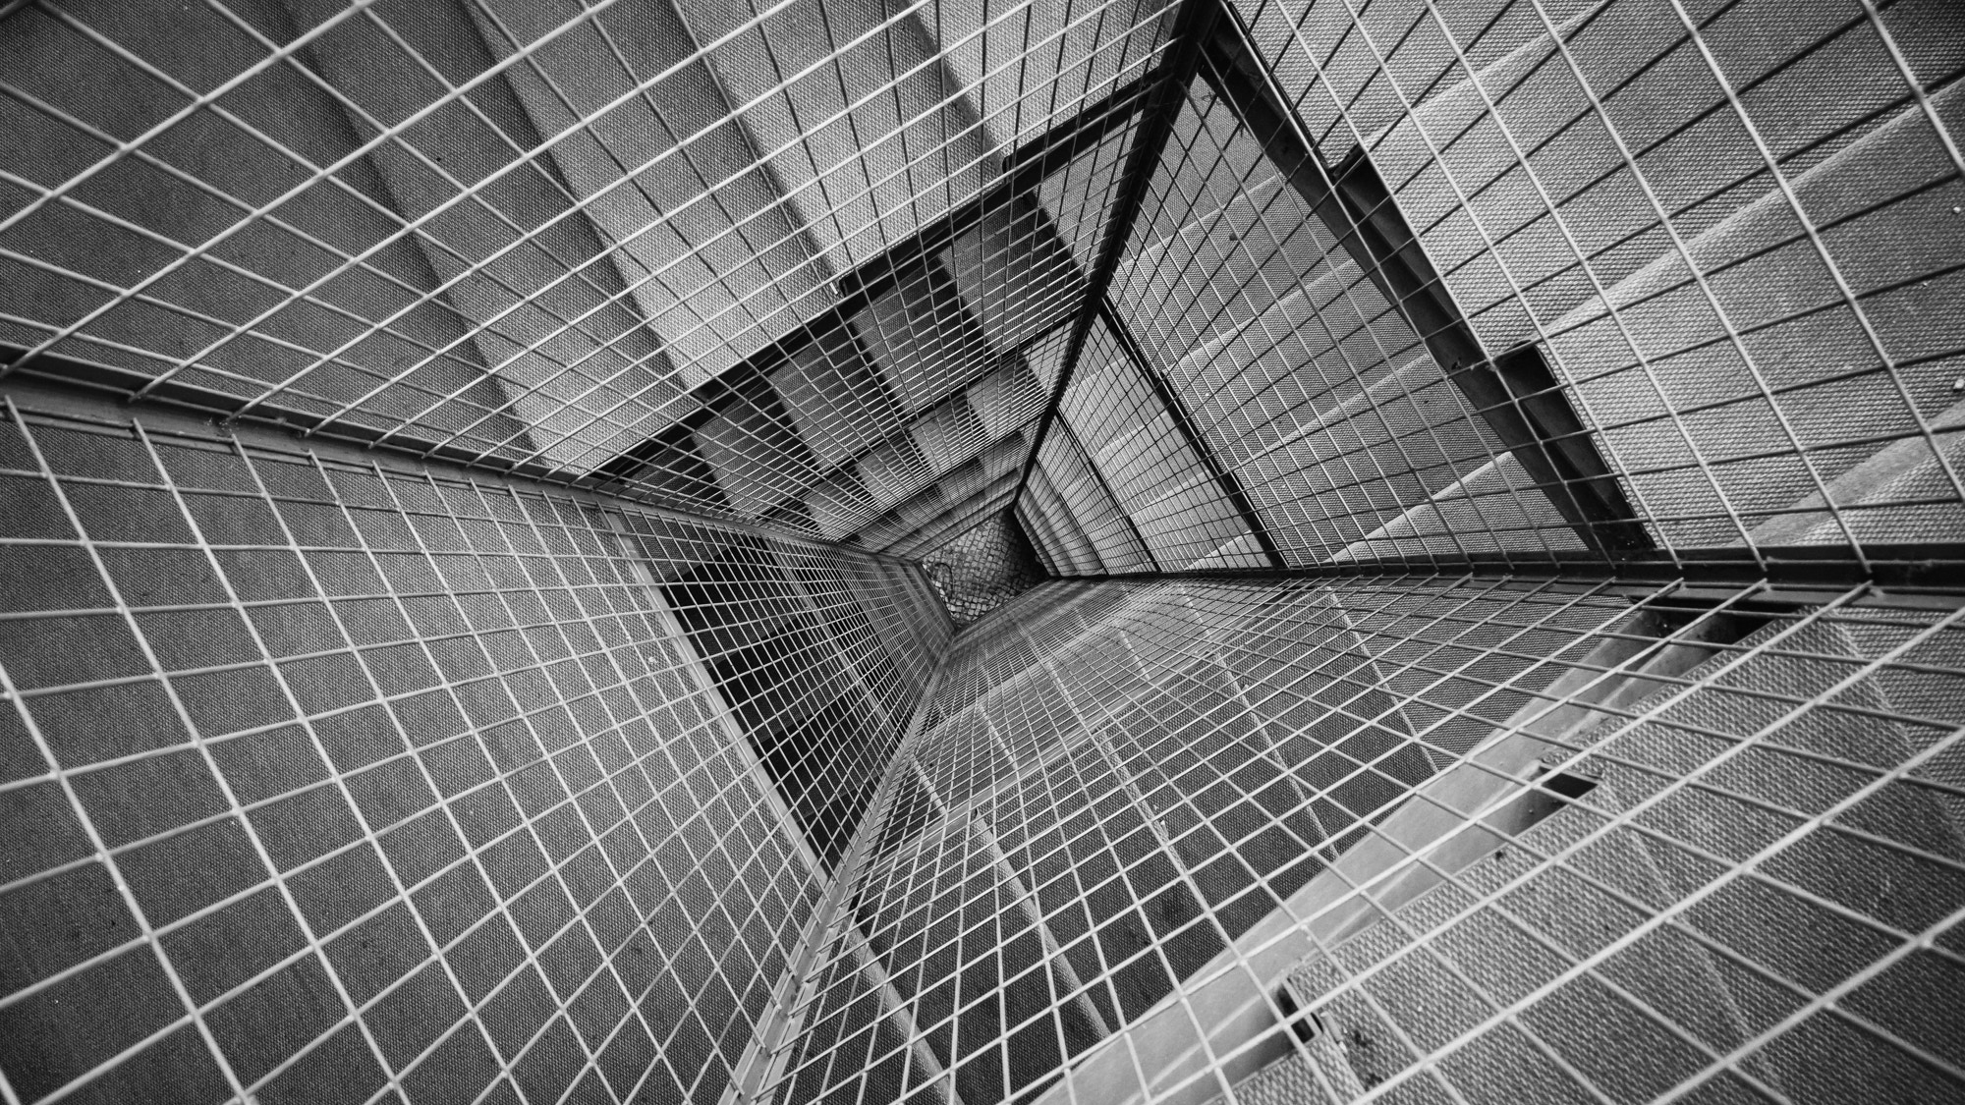
Encryption of data into an image Steganography
Algorithms in multimedia and machine learning in the Python environment
Ofek Gamliel
Arik Siboni

Slide 2
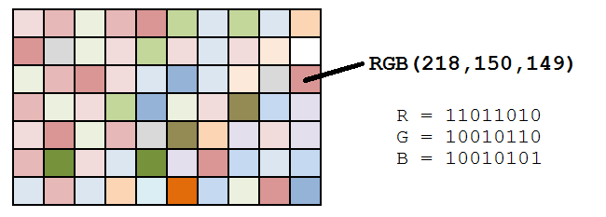
What is steganography?
Steganography is the practice of concealing a file, message, image, or video within another file, message, image, or video.
What is the advantage of steganography over cryptography?
The advantage of steganography over cryptography alone is that the intended secret message does not attract attention to itself as an object of scrutiny. Plainly visible encrypted messages, no matter how unbreakable they are, arouse interest and may in themselves be incriminating in countries in which encryption is illegal.
Pixel concept and color models
pixels are the smallest individual element of an image. So, each pixel is a sample of an original image. It means, more samples provide more accurate representations of the original. In color imaging systems, a color is typically represented by three or four component intensities such as red, green, and blue, or cyan, magenta, yellow, and black.
Here, we will work with the RGB color model. As you know, the RGB color model has 3 channels, red, green and blue.
So, each pixel from the image is composed of 3 values (red, green, blue) which are 8-bit values (the range is 0–255).

Slide 3

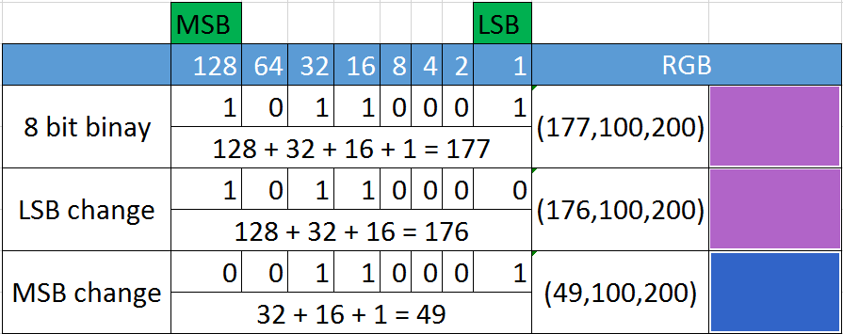
As we can see in the image above, for each pixel we have three values, which can be represented in binary code (the computer language).
When working with binary codes, we have more significant bits and less significant bits, as you can see in the image below.
Encoding using LSB method
The leftmost bit is the most significant bit. If we change the leftmost bit it will have a large impact on the final value. For example, if we change the leftmost bit from 1 to 0 (11111111 to 01111111) it will change the decimal value from 255 to 127.
On the other hand, the rightmost bit is the less significant bit. If we change the rightmost bit it will have less impact on the final value. For example, if we change the leftmost bit from 1 to 0 (11111111 to 11111110) it will change the decimal value from 255 to 254. Note that the rightmost bit will change only 1 in a range of 256 (it represents less than 1%).
So, if we change the rightmost bits it will have a small visual impact on the final image. This is the steganography key to hide an image inside another. Change the less significant bits from an image and include the most significant bits from the other image.
The difference is negligible

Slide 4

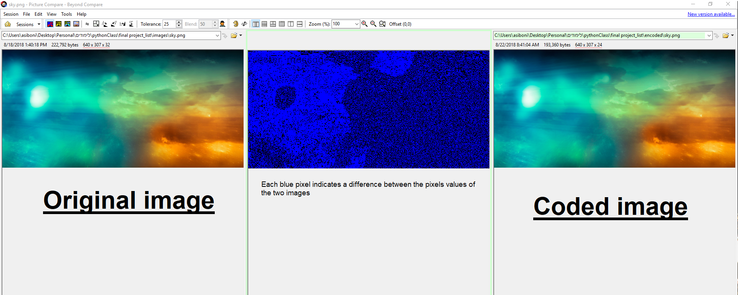
Our implementation for steganography will be placed on the red channel. Meaning that we will change only the LSB of every pixel on the red channel to one or zero based on our image with text (every place where there is a text area will be equal to 1 )
But not everything is perfect…
Although the change is not visible, if someone wants to check whether the picture is coded, he can do it in a variety of ways if he has two pictures, the original and the encoded. He can compare all the channels and compare the channel values in the original image and the encoded image and understand if there are differences. In addition, there are many image comparison programs (for example, Beyond Compare) that will display the different pixels between the original image and the encrypted image

Slide 5
Algorithm
Summary : The algorithm receives a user choice that tells ,whether to decode or encode an image. If he chooses to encode we will create an image with the desired text and embed it into image chosen by the user. Otherwise, if the user chooses to decode, the user will choose a picture in which the secret is embedded and the algorithm will display a decoded picture where the secret is written. Algorithm functions Image encoding –
Encoding will be done on the red channel using LSB method.
Encoding involves 3 functions :
WriteText –
creates a new black image with size based on image selected for encoding, write a secret message in white, then converting the image into “B&W” ( 8 bit,(255,255,255)will present white and (0,0,0) will represent black ) so in encoding part we can distinguish between the text part in the image to the rest of the black image
BinUpdate –
responsible for updating red channel pixels by changing the LSB of the source image to 1 or 0 if text was spotted (white pixel) by the return value of writeText function.
Encode image - We will iterate throw each pixel simultaneously on the image we received from write_text and the red channel of the image selected for encoding. If we reach a pixel painted in white (255,255,255) in the picture where the text is written, we will change the LSB bit in the red channel of the selected image to 1. Otherwise, we will change the same bit to 0 Image decoding–
We will start by creating blank black image, Iterate through every pixel of the encoded image red channel and checks if the LSB is equal to 1 or 0 . If its equal to 1 – there is a hidden text on this pixel so will convert the same pixel in our blank image to (255,255,255) – white . Otherwise, the pixel will remain in the same state, black (0.0,0,)
ListFiles –
responsible for representing list of images based on user selection for decoding or encoding.

Slide 6
Difficulties encountered and ways of approach
Identify which pixels are part of the encoded sentence in the image containing the text in order to encode those pixels in the input image?
At first, there was no Single tone to the written sentence pixels. Therefore, we created a black background and each pixel of the sentence was painted white, thus we obtained an absolute separation between a white pixel that is part of the encoded sentence and a black pixel that is part of the black background.
2. Why do we need to update the red channel value if the value on the image with text doesn’t contain a pixel with text in it?
We update every LSB in the red channel because at the encoding stage we are already thinking about the decoding stage, we want to make sure that if the LSB in the encoded image is equal to 1, this part of the encrypted message necessarily hides in this pixel. Therefore, in the other pixels we will initialize the LSB in the red channel to 0.
3. In case we found a pixel with a text in it on the image text- how to update its LSB.
We will convert the decimal value of the red channel to binary number, and replace the rightmost digit (this is the LSB character) to ‘1’.
4. Less ideal pictures format that suitable for encoding:
a. PNG - images with "transparent" pixels - Although the text can be encoded in PNG images with transparent pixels, this is not ideal because the change in the image is
clearly visible, so in the code whose purpose is image encryption we want to make as few visible changes as possible.
b. jpeg -Although we can open a jpeg image in order to encrypt the text, we can not save the image in the same format (jpeg) because this format is a compression format,
which means that some of the information changes in the saving process and can not be restored.
Therefore, we chose to save the encrypted image in PNG format, a format that does not go through data compression while saving.

